Slide 1
Lecture 19 Recursion

Slide 2
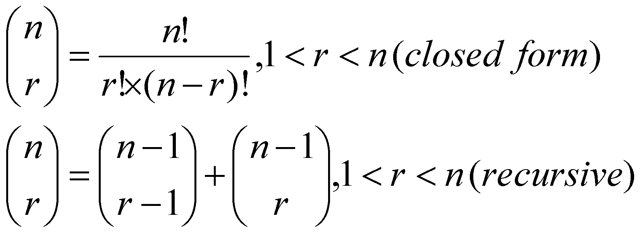
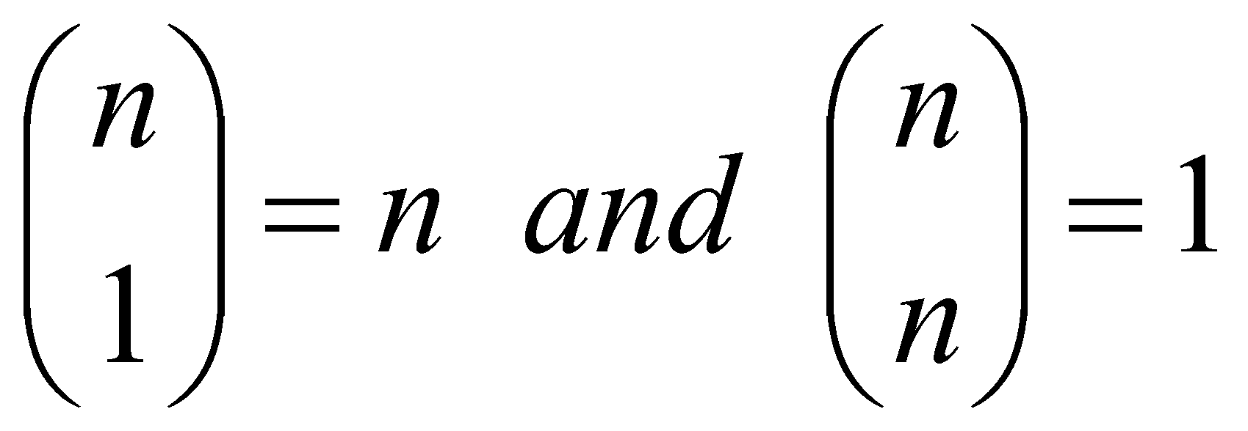
Another Example: n choose r (combinations)
Given n things, how many different sets of size k can be chosen?
with base cases:

Slide 3
n choose r (Combinations)
int Combinations(int n, int r)
{
if(r == 1) // base case 1
return n;
else if (n == r) // base case 2
return 1;
else //general case
return(Combinations(n-1, r-1) + Combinations(n-1, r));
}

Slide 4
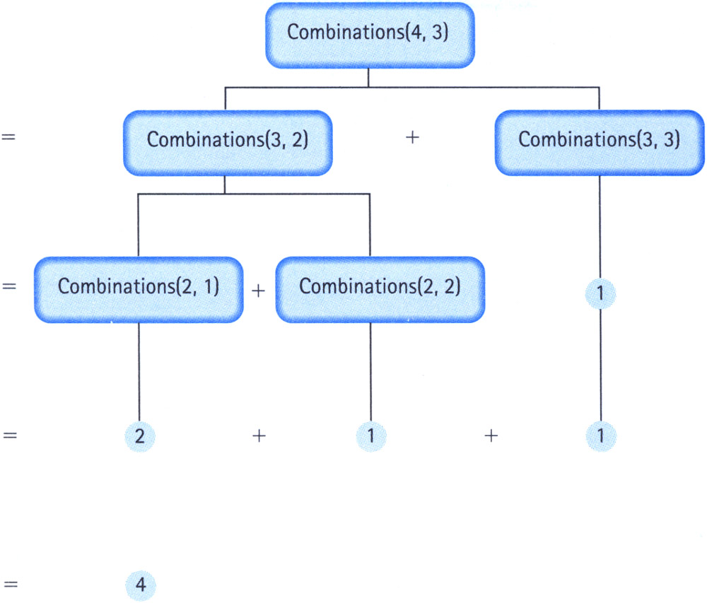
Tracing Combinations(4,3)

Slide 5
Binary Search: The Recursive Way
Base case:
Array is empty: item not found
Array is non-empty and item is the middle element: item is found
General case:
Search either the right half or the left half of the array

Slide 6
Binary Search: The Recursive Way
template<class ItemType>
bool BinarySearch(ItemType info[], ItemType item, int fromLocation, int toLocation)
{
if (fromLocation > toLocation) // Base case 1
return false;
else
{
int midPoint;
midPoint = (fromLocation + toLocation) / 2;
if (item < info[midPoint])
return BinarySearch(info, item, fromLocation, midPoint - 1);
else if (item == info[midPoint]) // Base case 2
return true;
else
return BinarySearch(info, item, midPoint + 1, toLocation);
}
}

Slide 7
index | 0 | 1 | 2 | 3 | 4 | 5 | 6 | 7 | 8 | 9 | 10
value | 1 | 3 | 5 | 8 | 9 | 17 | 32 | 36 | 42 | 49 | 53
A

Slide 8
index | 0 | 1 | 2 | 3 | 4 | 5 | 6 | 7 | 8 | 9 | 10
value | 1 | 3 | 5 | 8 | 9 | 17 | 32 | 36 | 42 | 49 | 53
A
Find 9:

Slide 9
index | 0 | 1 | 2 | 3 | 4 | 5 | 6 | 7 | 8 | 9 | 10
value | 1 | 3 | 5 | 8 | 9 | 17 | 32 | 36 | 42 | 49 | 53
A
Find 9:
call
BinarySearch(A,9,0,10)

Slide 10
index | 0 | 1 | 2 | 3 | 4 | 5 | 6 | 7 | 8 | 9 | 10
value | 1 | 3 | 5 | 8 | 9 | 17 | 32 | 36 | 42 | 49 | 53
A
Find 9:
call
BinarySearch(A,9,0,10)
call
BinarySearch(A,9,0,4)

Slide 11
index | 0 | 1 | 2 | 3 | 4 | 5 | 6 | 7 | 8 | 9 | 10
value | 1 | 3 | 5 | 8 | 9 | 17 | 32 | 36 | 42 | 49 | 53
A
Find 9:
call
BinarySearch(A,9,0,10)
call
BinarySearch(A,9,0,4)
call
BinarySearch(A,9,3,4)

Slide 12
index | 0 | 1 | 2 | 3 | 4 | 5 | 6 | 7 | 8 | 9 | 10
value | 1 | 3 | 5 | 8 | 9 | 17 | 32 | 36 | 42 | 49 | 53
A
Find 9:
call
BinarySearch(A,9,0,10)
call
BinarySearch(A,9,0,4)
call
BinarySearch(A,9,3,4)
call
BinarySearch(A,9,4,4)

Slide 13
index | 0 | 1 | 2 | 3 | 4 | 5 | 6 | 7 | 8 | 9 | 10
value | 1 | 3 | 5 | 8 | 9 | 17 | 32 | 36 | 42 | 49 | 53
A
Find 9:
call
BinarySearch(A,9,0,10)
call
BinarySearch(A,9,0,4)
call
BinarySearch(A,9,3,4)
call
return true
BinarySearch(A,9,4,4)

Slide 14
index | 0 | 1 | 2 | 3 | 4 | 5 | 6 | 7 | 8 | 9 | 10
value | 1 | 3 | 5 | 8 | 9 | 17 | 32 | 36 | 42 | 49 | 53
A
Find 9:
call
BinarySearch(A,9,0,10)
call
BinarySearch(A,9,0,4)
return true
call
BinarySearch(A,9,3,4)
call
return true
BinarySearch(A,9,4,4)

Slide 15
index | 0 | 1 | 2 | 3 | 4 | 5 | 6 | 7 | 8 | 9 | 10
value | 1 | 3 | 5 | 8 | 9 | 17 | 32 | 36 | 42 | 49 | 53
A
Find 9:
call
BinarySearch(A,9,0,10)
return true
call
BinarySearch(A,9,0,4)
return true
call
BinarySearch(A,9,3,4)
call
return true
BinarySearch(A,9,4,4)

Slide 16
index | 0 | 1 | 2 | 3 | 4 | 5 | 6 | 7 | 8 | 9 | 10
value | 1 | 3 | 5 | 8 | 9 | 17 | 32 | 36 | 42 | 49 | 53
A
return true
Find 9:
call
BinarySearch(A,9,0,10)
return true
call
BinarySearch(A,9,0,4)
return true
call
BinarySearch(A,9,3,4)
call
return true
BinarySearch(A,9,4,4)

Slide 17
index | 0 | 1 | 2 | 3 | 4 | 5 | 6 | 7 | 8 | 9 | 10
value | 1 | 3 | 5 | 8 | 9 | 17 | 32 | 36 | 42 | 49 | 53
A

Slide 18
index | 0 | 1 | 2 | 3 | 4 | 5 | 6 | 7 | 8 | 9 | 10
value | 1 | 3 | 5 | 8 | 9 | 17 | 32 | 36 | 42 | 49 | 53
A
Find 20:

Slide 19
index | 0 | 1 | 2 | 3 | 4 | 5 | 6 | 7 | 8 | 9 | 10
value | 1 | 3 | 5 | 8 | 9 | 17 | 32 | 36 | 42 | 49 | 53
A
Find 20:
call
BinarySearch(A,20,0,10)

Slide 20
index | 0 | 1 | 2 | 3 | 4 | 5 | 6 | 7 | 8 | 9 | 10
value | 1 | 3 | 5 | 8 | 9 | 17 | 32 | 36 | 42 | 49 | 53
A
Find 20:
call
BinarySearch(A,20,0,10)
call
BinarySearch(A,20,6,10)

Slide 21
index | 0 | 1 | 2 | 3 | 4 | 5 | 6 | 7 | 8 | 9 | 10
value | 1 | 3 | 5 | 8 | 9 | 17 | 32 | 36 | 42 | 49 | 53
A
Find 20:
call
BinarySearch(A,20,0,10)
call
BinarySearch(A,20,6,10)
call
BinarySearch(A,20,6,7)

Slide 22
index | 0 | 1 | 2 | 3 | 4 | 5 | 6 | 7 | 8 | 9 | 10
value | 1 | 3 | 5 | 8 | 9 | 17 | 32 | 36 | 42 | 49 | 53
A
Find 20:
call
BinarySearch(A,20,0,10)
call
BinarySearch(A,20,6,10)
call
BinarySearch(A,20,6,7)
call
BinarySearch(A,20,6,5)

Slide 23
index | 0 | 1 | 2 | 3 | 4 | 5 | 6 | 7 | 8 | 9 | 10
value | 1 | 3 | 5 | 8 | 9 | 17 | 32 | 36 | 42 | 49 | 53
A
Find 20:
call
BinarySearch(A,20,0,10)
call
BinarySearch(A,20,6,10)
call
BinarySearch(A,20,6,7)
call
return false
BinarySearch(A,20,6,5)

Slide 24
index | 0 | 1 | 2 | 3 | 4 | 5 | 6 | 7 | 8 | 9 | 10
value | 1 | 3 | 5 | 8 | 9 | 17 | 32 | 36 | 42 | 49 | 53
A
Find 20:
call
BinarySearch(A,20,0,10)
call
BinarySearch(A,20,6,10)
call
return false
BinarySearch(A,20,6,7)
call
return false
BinarySearch(A,20,6,5)

Slide 25
index | 0 | 1 | 2 | 3 | 4 | 5 | 6 | 7 | 8 | 9 | 10
value | 1 | 3 | 5 | 8 | 9 | 17 | 32 | 36 | 42 | 49 | 53
A
Find 20:
call
BinarySearch(A,20,0,10)
return false
call
BinarySearch(A,20,6,10)
call
return false
BinarySearch(A,20,6,7)
call
return false
BinarySearch(A,20,6,5)

Slide 26
index | 0 | 1 | 2 | 3 | 4 | 5 | 6 | 7 | 8 | 9 | 10
value | 1 | 3 | 5 | 8 | 9 | 17 | 32 | 36 | 42 | 49 | 53
A
return false
Find 20:
call
BinarySearch(A,20,0,10)
return false
call
BinarySearch(A,20,6,10)
call
return false
BinarySearch(A,20,6,7)
call
return false
BinarySearch(A,20,6,5)

Slide 27
Recursive InsertItem (sorted linked list)
template<class ItemType>
void Insert(NodeType<ItemType>*& listPtr, ItemType item)
{
if (listPtr == NULL || item < listPtr->info)
{
// Save current pointer.
NodeType<ItemType>* tempPtr = listPtr;
// Get a new node.
listPtr = new NodeType<ItemType>;
listPtr->info = item;
listPtr->next = tempPtr;
}
else Insert(listPtr->next, item);
}

Slide 28
Recursive DeleteItem (sorted linked list)
template<class ItemType>
void Delete(NodeType<ItemType>*& listPtr, ItemType item)
(
if (item == listPtr->info)
{
NodeType<ItemType>* tempPtr = listPtr;
listPtr = listPtr->next;
delete tempPtr;
}
else
Delete(listPtr->next, item)
}

Slide 29
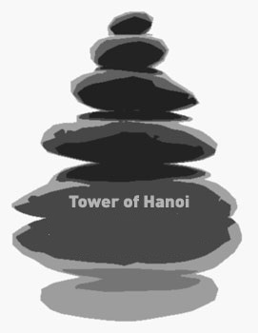

Slide 30
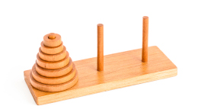
The Puzzle
Tower of Hanoi is a mathematical puzzle invented by a French Mathematician Edouard Lucas in 1883.
The game starts by having few discs stacked in increasing order of size. The number of discs can vary, but there are only three pegs.

Slide 31
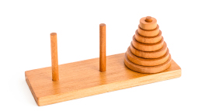
The Puzzle
The Objective is to transfer the entire tower to one of the other pegs. However you can only move one disk at a time and you can never stack a larger disk onto a smaller disk. Try to solve it in fewest possible moves.

Slide 32
Rules
Move one disc at a time.
You can not put a large disk on top of a small disc while moving.

Slide 33
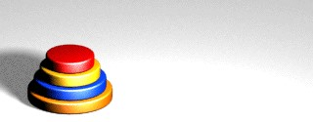
Solve Hanoi with 4 Discs

Slide 34
Solve Hanoi with 4 Discs

Slide 35
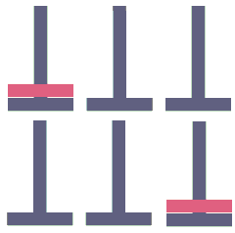
Recursive Solution
Problem: Move N discs from source peg to destination peg using auxiliary peg as via
Base case:
Move disc from source peg to destination peg (N = 1)

Slide 36
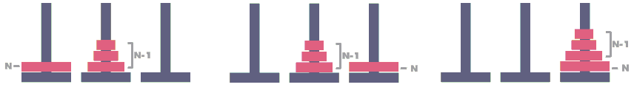
Recursive Solution
Problem: Move N discs from source peg to destination peg using auxiliary peg as via
General case:
Move N-1 discs from source peg to auxiliary peg via destination peg
Move disc from source peg to destination peg
Move N-1 discs from auxiliary peg to destination peg via source peg

Slide 37
Recursive Function for Solving Hanoi
#include <stdio.h>
void hanoi(int n, char beg, char aux, char end)
{
if(n == 1)
printf("Move disc from peg %c to peg %c\n", beg, end);
else
{
hanoi(n-1, beg, end, aux);
hanoi(1, beg, aux, end);
hanoi(n-1, aux, beg, end);
}
}
int main()
{
hanoi(4, 'A', 'B', 'C');
return 0;
}

Slide 38
hanoi(n-1, beg, end, aux);
hanoi(1, beg, aux, end);
hanoi(n-1, aux, beg, end);
H(4,A,B,C)
A
B
C

Slide 39
hanoi(n-1, beg, end, aux);
hanoi(1, beg, aux, end);
hanoi(n-1, aux, beg, end);
H(3,A,C,B)
H(4,A,B,C)
H(1,A,B,C)
H(3,B,A,C)
A
B
C

Slide 40
hanoi(n-1, beg, end, aux);
hanoi(1, beg, aux, end);
hanoi(n-1, aux, beg, end);
H(2,A,B,C)
H(1,A,C,B)
H(3,A,C,B)
H(2,C,A,B)
H(4,A,B,C)
H(1,A,B,C)
H(3,B,A,C)
A
B
C

Slide 41
hanoi(n-1, beg, end, aux);
hanoi(1, beg, aux, end);
hanoi(n-1, aux, beg, end);
H(1,A,C,B)
H(1,A,B,C)
H(1,B,A,C)
H(2,A,B,C)
H(1,A,C,B)
H(3,A,C,B)
H(2,C,A,B)
H(4,A,B,C)
H(1,A,B,C)
H(3,B,A,C)
A
B
C

Slide 42
hanoi(n-1, beg, end, aux);
hanoi(1, beg, aux, end);
hanoi(n-1, aux, beg, end);
H(1,A,C,B)
H(1,A,B,C)
H(1,B,A,C)
H(2,A,B,C)
H(1,A,C,B)
H(3,A,C,B)
H(2,C,A,B)
H(4,A,B,C)
H(1,A,B,C)
H(3,B,A,C)
A
B
C

Slide 43
hanoi(n-1, beg, end, aux);
hanoi(1, beg, aux, end);
hanoi(n-1, aux, beg, end);
H(1,A,C,B)
H(1,A,B,C)
H(1,B,A,C)
H(2,A,B,C)
H(1,A,C,B)
H(3,A,C,B)
H(2,C,A,B)
H(4,A,B,C)
H(1,A,B,C)
H(3,B,A,C)
A
B
C

Slide 44
hanoi(n-1, beg, end, aux);
hanoi(1, beg, aux, end);
hanoi(n-1, aux, beg, end);
H(1,A,C,B)
H(1,A,B,C)
H(1,B,A,C)
H(2,A,B,C)
H(1,A,C,B)
H(3,A,C,B)
H(2,C,A,B)
H(4,A,B,C)
H(1,A,B,C)
H(3,B,A,C)
A
B
C

Slide 45
hanoi(n-1, beg, end, aux);
hanoi(1, beg, aux, end);
hanoi(n-1, aux, beg, end);
H(1,A,C,B)
H(1,A,B,C)
H(1,B,A,C)
H(2,A,B,C)
H(1,A,C,B)
H(3,A,C,B)
H(2,C,A,B)
H(4,A,B,C)
H(1,A,B,C)
H(3,B,A,C)
A
B
C

Slide 46
hanoi(n-1, beg, end, aux);
hanoi(1, beg, aux, end);
hanoi(n-1, aux, beg, end);
H(1,A,C,B)
H(1,A,B,C)
H(1,B,A,C)
H(2,A,B,C)
H(1,A,C,B)
H(3,A,C,B)
H(2,C,A,B)
H(4,A,B,C)
H(1,A,B,C)
H(3,B,A,C)
A
B
C

Slide 47
hanoi(n-1, beg, end, aux);
hanoi(1, beg, aux, end);
hanoi(n-1, aux, beg, end);
H(1,A,C,B)
H(1,A,B,C)
H(1,B,A,C)
H(2,A,B,C)
H(1,A,C,B)
H(3,A,C,B)
H(2,C,A,B)
H(4,A,B,C)
H(1,A,B,C)
H(3,B,A,C)
A
B
C

Slide 48
hanoi(n-1, beg, end, aux);
hanoi(1, beg, aux, end);
hanoi(n-1, aux, beg, end);
H(1,A,C,B)
H(1,A,B,C)
H(1,B,A,C)
H(2,A,B,C)
H(1,C,B,A)
H(1,A,C,B)
H(1,C,A,B)
H(3,A,C,B)
H(2,C,A,B)
H(1,A,C,B)
H(4,A,B,C)
H(1,A,B,C)
H(3,B,A,C)
A
B
C

Slide 49
hanoi(n-1, beg, end, aux);
hanoi(1, beg, aux, end);
hanoi(n-1, aux, beg, end);
H(1,A,C,B)
H(1,A,B,C)
H(1,B,A,C)
H(2,A,B,C)
H(1,C,B,A)
H(1,A,C,B)
H(1,C,A,B)
H(3,A,C,B)
H(2,C,A,B)
H(1,A,C,B)
H(4,A,B,C)
H(1,A,B,C)
H(3,B,A,C)
A
B
C

Slide 50
hanoi(n-1, beg, end, aux);
hanoi(1, beg, aux, end);
hanoi(n-1, aux, beg, end);
H(1,A,C,B)
H(1,A,B,C)
H(1,B,A,C)
H(2,A,B,C)
H(1,C,B,A)
H(1,A,C,B)
H(1,C,A,B)
H(3,A,C,B)
H(2,C,A,B)
H(1,A,C,B)
H(4,A,B,C)
H(1,A,B,C)
H(3,B,A,C)
A
B
C

Slide 51
hanoi(n-1, beg, end, aux);
hanoi(1, beg, aux, end);
hanoi(n-1, aux, beg, end);
H(1,A,C,B)
H(1,A,B,C)
H(1,B,A,C)
H(2,A,B,C)
H(1,C,B,A)
H(1,A,C,B)
H(1,C,A,B)
H(3,A,C,B)
H(2,C,A,B)
H(1,A,C,B)
H(4,A,B,C)
H(1,A,B,C)
H(3,B,A,C)
A
B
C

Slide 52
hanoi(n-1, beg, end, aux);
hanoi(1, beg, aux, end);
hanoi(n-1, aux, beg, end);
H(1,A,C,B)
H(1,A,B,C)
H(1,B,A,C)
H(2,A,B,C)
H(1,C,B,A)
H(1,A,C,B)
H(1,C,A,B)
H(3,A,C,B)
H(2,C,A,B)
H(1,A,C,B)
H(4,A,B,C)
H(1,A,B,C)
H(3,B,A,C)
A
B
C

Slide 53
hanoi(n-1, beg, end, aux);
hanoi(1, beg, aux, end);
hanoi(n-1, aux, beg, end);
H(1,A,C,B)
H(1,A,B,C)
H(1,B,A,C)
H(2,A,B,C)
H(1,C,B,A)
H(1,A,C,B)
H(1,C,A,B)
H(3,A,C,B)
H(2,C,A,B)
H(1,A,C,B)
H(4,A,B,C)
H(1,A,B,C)
H(3,B,A,C)
A
B
C

Slide 54
hanoi(n-1, beg, end, aux);
hanoi(1, beg, aux, end);
hanoi(n-1, aux, beg, end);
H(1,A,C,B)
H(1,A,B,C)
H(1,B,A,C)
H(2,A,B,C)
H(1,C,B,A)
H(1,A,C,B)
H(1,C,A,B)
H(3,A,C,B)
H(2,C,A,B)
H(1,A,C,B)
H(4,A,B,C)
H(1,A,B,C)
H(3,B,A,C)
A
B
C

Slide 55
hanoi(n-1, beg, end, aux);
hanoi(1, beg, aux, end);
hanoi(n-1, aux, beg, end);
H(1,A,C,B)
H(1,A,B,C)
H(1,B,A,C)
H(2,A,B,C)
H(1,C,B,A)
H(1,A,C,B)
H(1,C,A,B)
H(3,A,C,B)
H(2,C,A,B)
H(1,A,C,B)
H(4,A,B,C)
H(1,A,B,C)
H(3,B,A,C)
A
B
C

Slide 56
hanoi(n-1, beg, end, aux);
hanoi(1, beg, aux, end);
hanoi(n-1, aux, beg, end);
H(1,A,C,B)
H(1,A,B,C)
H(1,B,A,C)
H(2,A,B,C)
H(1,C,B,A)
H(1,A,C,B)
H(1,C,A,B)
H(3,A,C,B)
H(2,C,A,B)
H(1,A,C,B)
H(4,A,B,C)
H(1,A,B,C)
H(2,B,C,A)
H(3,B,A,C)
H(1,B,A,C)
H(2,A,B,C)
A
B
C

Slide 57
hanoi(n-1, beg, end, aux);
hanoi(1, beg, aux, end);
hanoi(n-1, aux, beg, end);
H(1,A,C,B)
H(1,A,B,C)
H(1,B,A,C)
H(2,A,B,C)
H(1,C,B,A)
H(1,A,C,B)
H(1,C,A,B)
H(3,A,C,B)
H(2,C,A,B)
H(1,A,C,B)
H(4,A,B,C)
H(1,A,B,C)
H(2,B,C,A)
H(1,B,A,C)
H(3,B,A,C)
H(1,B,A,C)
H(1,B,C,A)
H(2,A,B,C)
H(1,C,B,A)
A
B
C

Slide 58
hanoi(n-1, beg, end, aux);
hanoi(1, beg, aux, end);
hanoi(n-1, aux, beg, end);
H(1,A,C,B)
H(1,A,B,C)
H(1,B,A,C)
H(2,A,B,C)
H(1,C,B,A)
H(1,A,C,B)
H(1,C,A,B)
H(3,A,C,B)
H(2,C,A,B)
H(1,A,C,B)
H(4,A,B,C)
H(1,A,B,C)
H(2,B,C,A)
H(1,B,A,C)
H(3,B,A,C)
H(1,B,A,C)
H(1,B,C,A)
H(2,A,B,C)
H(1,C,B,A)
A
B
C

Slide 59
hanoi(n-1, beg, end, aux);
hanoi(1, beg, aux, end);
hanoi(n-1, aux, beg, end);
H(1,A,C,B)
H(1,A,B,C)
H(1,B,A,C)
H(2,A,B,C)
H(1,C,B,A)
H(1,A,C,B)
H(1,C,A,B)
H(3,A,C,B)
H(2,C,A,B)
H(1,A,C,B)
H(4,A,B,C)
H(1,A,B,C)
H(2,B,C,A)
H(1,B,A,C)
H(3,B,A,C)
H(1,B,A,C)
H(1,B,C,A)
H(2,A,B,C)
H(1,C,B,A)
A
B
C

Slide 60
hanoi(n-1, beg, end, aux);
hanoi(1, beg, aux, end);
hanoi(n-1, aux, beg, end);
H(1,A,C,B)
H(1,A,B,C)
H(1,B,A,C)
H(2,A,B,C)
H(1,C,B,A)
H(1,A,C,B)
H(1,C,A,B)
H(3,A,C,B)
H(2,C,A,B)
H(1,A,C,B)
H(4,A,B,C)
H(1,A,B,C)
H(2,B,C,A)
H(1,B,A,C)
H(3,B,A,C)
H(1,B,A,C)
H(1,B,C,A)
H(2,A,B,C)
H(1,C,B,A)
A
B
C

Slide 61
hanoi(n-1, beg, end, aux);
hanoi(1, beg, aux, end);
hanoi(n-1, aux, beg, end);
H(1,A,C,B)
H(1,A,B,C)
H(1,B,A,C)
H(2,A,B,C)
H(1,C,B,A)
H(1,A,C,B)
H(1,C,A,B)
H(3,A,C,B)
H(2,C,A,B)
H(1,A,C,B)
H(4,A,B,C)
H(1,A,B,C)
H(2,B,C,A)
H(1,B,A,C)
H(3,B,A,C)
H(1,B,A,C)
H(1,B,C,A)
H(2,A,B,C)
H(1,C,B,A)
A
B
C

Slide 62
hanoi(n-1, beg, end, aux);
hanoi(1, beg, aux, end);
hanoi(n-1, aux, beg, end);
H(1,A,C,B)
H(1,A,B,C)
H(1,B,A,C)
H(2,A,B,C)
H(1,C,B,A)
H(1,A,C,B)
H(1,C,A,B)
H(3,A,C,B)
H(2,C,A,B)
H(1,A,C,B)
H(4,A,B,C)
H(1,A,B,C)
H(2,B,C,A)
H(1,B,A,C)
H(3,B,A,C)
H(1,B,A,C)
H(1,B,C,A)
H(2,A,B,C)
H(1,C,B,A)
A
B
C

Slide 63
hanoi(n-1, beg, end, aux);
hanoi(1, beg, aux, end);
hanoi(n-1, aux, beg, end);
H(1,A,C,B)
H(1,A,B,C)
H(1,B,A,C)
H(2,A,B,C)
H(1,C,B,A)
H(1,A,C,B)
H(1,C,A,B)
H(3,A,C,B)
H(2,C,A,B)
H(1,A,C,B)
H(4,A,B,C)
H(1,A,B,C)
H(2,B,C,A)
H(1,B,A,C)
H(3,B,A,C)
H(1,B,A,C)
H(1,B,C,A)
H(2,A,B,C)
H(1,C,B,A)
A
B
C

Slide 64
hanoi(n-1, beg, end, aux);
hanoi(1, beg, aux, end);
hanoi(n-1, aux, beg, end);
H(1,A,C,B)
H(1,A,B,C)
H(1,B,A,C)
H(2,A,B,C)
H(1,C,B,A)
H(1,A,C,B)
H(1,C,A,B)
H(3,A,C,B)
H(2,C,A,B)
H(1,A,C,B)
H(4,A,B,C)
H(1,A,B,C)
H(2,B,C,A)
H(1,B,A,C)
H(3,B,A,C)
H(1,B,A,C)
H(1,B,C,A)
H(2,A,B,C)
H(1,C,B,A)
H(1,A,C,B)
A
B
C
H(1,A,B,C)
H(1,B,A,C)

Slide 65
hanoi(n-1, beg, end, aux);
hanoi(1, beg, aux, end);
hanoi(n-1, aux, beg, end);
H(1,A,C,B)
H(1,A,B,C)
H(1,B,A,C)
H(2,A,B,C)
H(1,C,B,A)
H(1,A,C,B)
H(1,C,A,B)
H(3,A,C,B)
H(2,C,A,B)
H(1,A,C,B)
H(4,A,B,C)
H(1,A,B,C)
H(2,B,C,A)
H(1,B,A,C)
H(3,B,A,C)
H(1,B,A,C)
H(1,B,C,A)
H(2,A,B,C)
H(1,C,B,A)
H(1,A,C,B)
A
B
C
H(1,A,B,C)
H(1,B,A,C)

Slide 66
hanoi(n-1, beg, end, aux);
hanoi(1, beg, aux, end);
hanoi(n-1, aux, beg, end);
H(1,A,C,B)
H(1,A,B,C)
H(1,B,A,C)
H(2,A,B,C)
H(1,C,B,A)
H(1,A,C,B)
H(1,C,A,B)
H(3,A,C,B)
H(2,C,A,B)
H(1,A,C,B)
H(4,A,B,C)
H(1,A,B,C)
H(2,B,C,A)
H(1,B,A,C)
H(3,B,A,C)
H(1,B,A,C)
H(1,B,C,A)
H(2,A,B,C)
H(1,C,B,A)
H(1,A,C,B)
A
B
C
H(1,A,B,C)
H(1,B,A,C)

Slide 67
hanoi(n-1, beg, end, aux);
hanoi(1, beg, aux, end);
hanoi(n-1, aux, beg, end);
H(1,A,C,B)
H(1,A,B,C)
H(1,B,A,C)
H(2,A,B,C)
H(1,C,B,A)
H(1,A,C,B)
H(1,C,A,B)
H(3,A,C,B)
H(2,C,A,B)
H(1,A,C,B)
H(4,A,B,C)
H(1,A,B,C)
H(2,B,C,A)
H(1,B,A,C)
H(3,B,A,C)
H(1,B,A,C)
H(1,B,C,A)
H(2,A,B,C)
H(1,C,B,A)
H(1,A,C,B)
A
B
C
H(1,A,B,C)
H(1,B,A,C)

Slide 68
hanoi(n-1, beg, end, aux);
hanoi(1, beg, aux, end);
hanoi(n-1, aux, beg, end);
H(1,A,C,B)
H(1,A,B,C)
H(1,B,A,C)
H(2,A,B,C)
H(1,C,B,A)
H(1,A,C,B)
H(1,C,A,B)
H(3,A,C,B)
H(2,C,A,B)
H(1,A,C,B)
H(4,A,B,C)
H(1,A,B,C)
H(2,B,C,A)
H(1,B,A,C)
H(3,B,A,C)
H(1,B,A,C)
H(1,B,C,A)
H(2,A,B,C)
H(1,C,B,A)
H(1,A,C,B)
A
B
C
H(1,A,B,C)
H(1,B,A,C)

Slide 69
hanoi(n-1, beg, end, aux);
hanoi(1, beg, aux, end);
hanoi(n-1, aux, beg, end);
H(1,A,C,B)
H(1,A,B,C)
H(1,B,A,C)
H(2,A,B,C)
H(1,C,B,A)
H(1,A,C,B)
H(1,C,A,B)
H(3,A,C,B)
H(2,C,A,B)
H(1,A,C,B)
H(4,A,B,C)
H(1,A,B,C)
H(2,B,C,A)
H(1,B,A,C)
H(3,B,A,C)
H(1,B,A,C)
H(1,B,C,A)
H(2,A,B,C)
H(1,C,B,A)
H(1,A,C,B)
A
B
C
H(1,A,B,C)
H(1,B,A,C)

Slide 70
hanoi(n-1, beg, end, aux);
hanoi(1, beg, aux, end);
hanoi(n-1, aux, beg, end);
H(1,A,C,B)
H(1,A,B,C)
H(1,B,A,C)
H(2,A,B,C)
H(1,C,B,A)
H(1,A,C,B)
H(1,C,A,B)
H(3,A,C,B)
H(2,C,A,B)
H(1,A,C,B)
H(4,A,B,C)
H(1,A,B,C)
H(2,B,C,A)
H(1,B,A,C)
H(3,B,A,C)
H(1,B,A,C)
H(1,B,C,A)
H(2,A,B,C)
H(1,C,B,A)
H(1,A,C,B)
A
B
C
H(1,A,B,C)
H(1,B,A,C)

Slide 71
hanoi(n-1, beg, end, aux);
hanoi(1, beg, aux, end);
hanoi(n-1, aux, beg, end);
H(1,A,C,B)
H(1,A,B,C)
H(1,B,A,C)
H(2,A,B,C)
H(1,C,B,A)
H(1,A,C,B)
H(1,C,A,B)
H(3,A,C,B)
H(2,C,A,B)
H(1,A,C,B)
H(4,A,B,C)
H(1,A,B,C)
H(2,B,C,A)
H(1,B,A,C)
H(3,B,A,C)
H(1,B,A,C)
H(1,B,C,A)
H(2,A,B,C)
H(1,C,B,A)
H(1,A,C,B)
A
B
C
H(1,A,B,C)
H(1,B,A,C)

